Slide 1

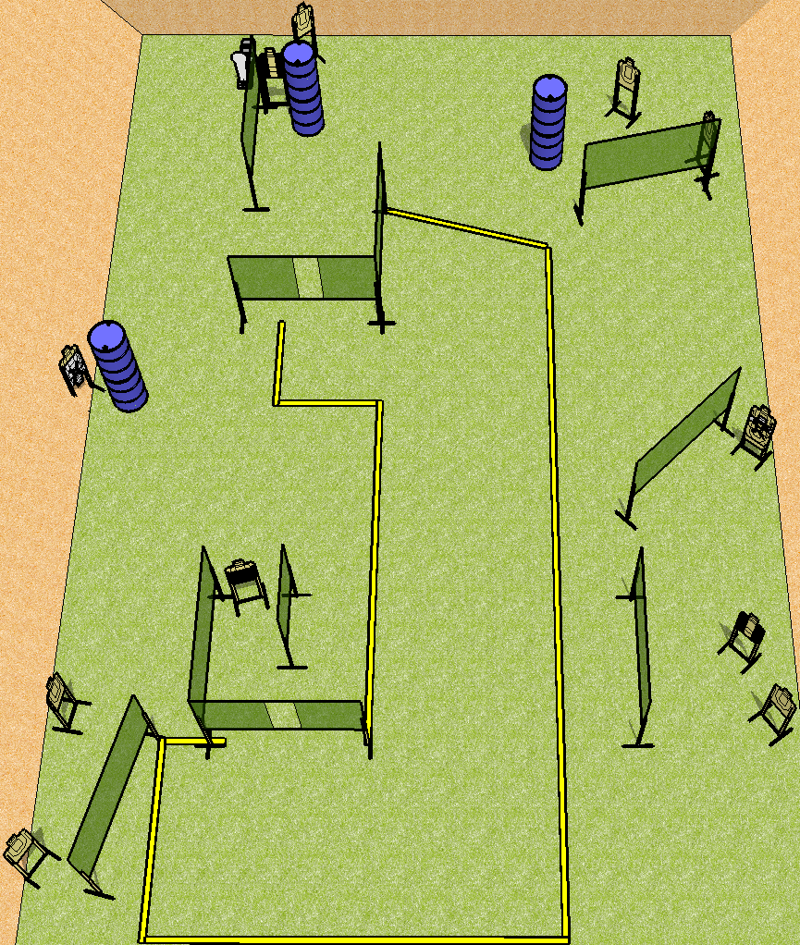
 | Dothan Practical Shooters – USPSA Match Periscope Course Designer : Drew Coleman Bay: A1
Round Count 25 rounds 12 USPSA 1 colt popper
Equipment List 18 wall feet 2 tux, 1 50% 11 targets (9 + 2NS)

Slide 2
Periscope
Written Stage Briefing
Scoring: Comstock Rounds: 25
Targets: 12 USPSA, steel
Handgun start position: hands touching marks, pistol loaded and holstered.
PCC start position: muzzle touching either mark, stock on belt. Loaded carbine is held with both hands.
Stage Procedure: on the audible start signal, engage targets as they become available from within the shooting area.

